Slide 1

Spark Joins, Partitioning, and Bucketing
---- Pranitha Bollepalli

Slide 2
Introduction - Spark Joins
Datasets in real-world scenarios are often stored separately but are related by common keys.
Joins allow you to bring these datasets together for meaningful analysis.
Joins are integral in Extract, Transform, Load (ETL) workflows, where data from different sources is combined and transformed into a unified format for analysis or storage.

Slide 3
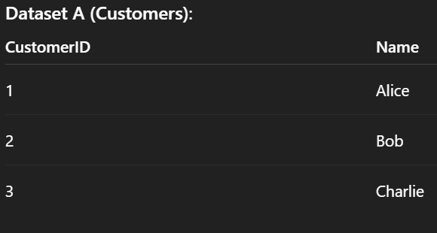
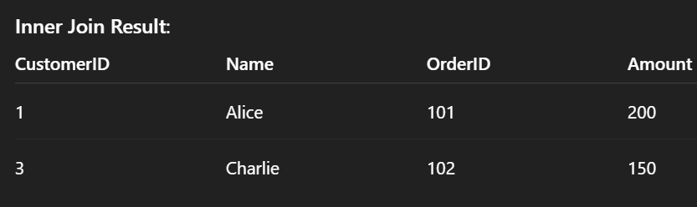
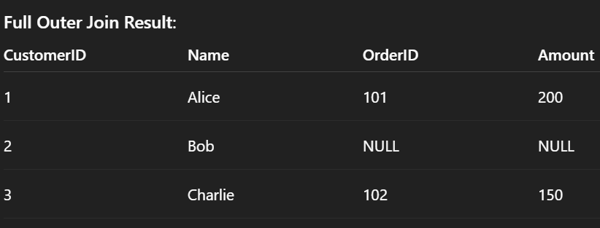
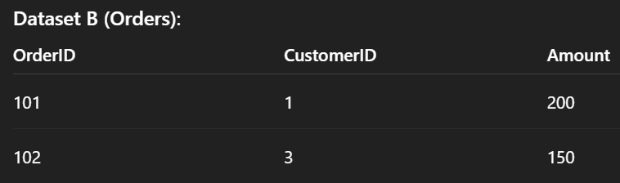
Types of Spark Joins
Inner Join: Matches rows with keys present in both datasets.
Full Outer Join: Includes rows from both datasets, even if no match exists.

Slide 4
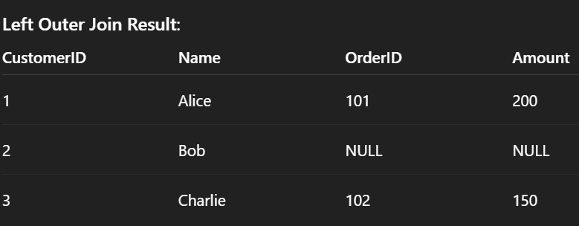
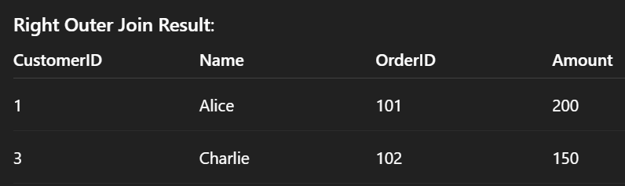
Types of Spark Joins
Left/Right Join: Includes all rows from the left/right dataset and matching rows from the other.

Slide 5
Broadcast Join
Copies the smaller dataset to all nodes, avoiding shuffling.
Use Case: When one dataset is significantly smaller.
Mechanism:
Identify the smaller dataset.
Broadcast it to all nodes.
Perform local joins on each node.
Example:
Small Dataset: Country codes.
Large Dataset: Transaction logs.
Join on country code.

Slide 6
Scenario
Imagine you’re analyzing online sales data for a global retail company.
Dataset 1: Millions of sales transactions (large).
Dataset 2: Product catalog with a few thousand items (small).
Use Case:
You want to join the sales dataset with the product catalog to add product names and categories to each sale.
Why Broadcast Join?
The product catalog is small enough to fit into memory.
Broadcasting avoids shuffling the large sales dataset across the network.

Slide 7
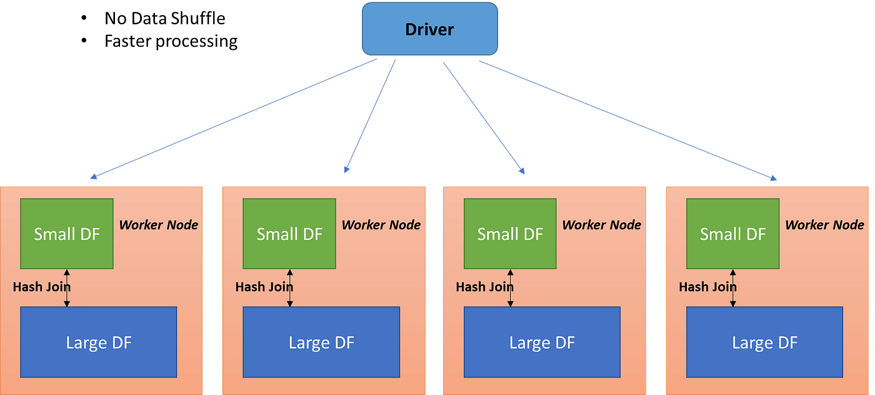
https://medium.com/@ghoshsiddharth25/apache-spark-join-strategies-deep-dive-26bf7e85db28

Slide 8
Hash Join
Uses a hash table for efficient key matching.
Use Case: When one dataset can fit in memory.
Mechanism:
Build Phase: Create a hash table from the smaller dataset.
Probe Phase: Match rows from the larger dataset by hashing the key.
Example:
Customers dataset (small).
Orders dataset (large).
Join on CustomerID.

Slide 9
Scenario
You are managing a food delivery service.
Dataset 1: Daily orders (moderate size).
Dataset 2: Customer database (moderate size).
Use Case:
You need to find customers who ordered food on a particular day to analyze behavior.
Why Hash Join?
Both datasets are manageable in size and keys (like customer IDs) are evenly distributed.
Hashing reduces the computational complexity compared to sorting.

Slide 10
Sort-Merge Join
Sorts both datasets on the join key and merges them.
Mechanism:
Sort both datasets by join key.
Perform merge join on sorted datasets.
Example:
Sorted sales data.
Sorted product data.
Join on ProductID.

Slide 11
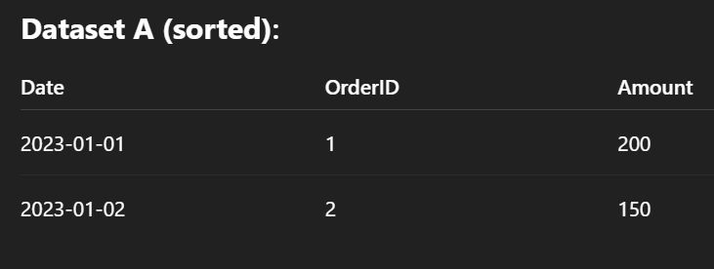
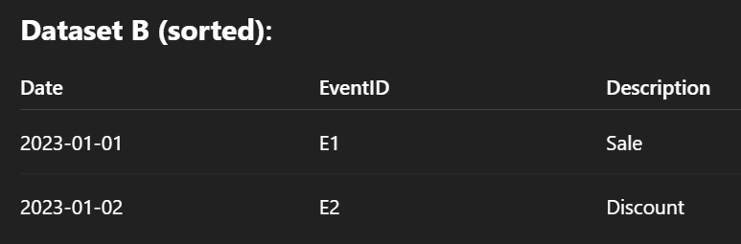
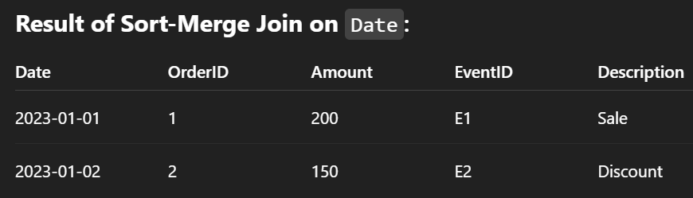

Slide 12
Scenario
You’re working for a streaming service analyzing user behavior.
Dataset 1: User interaction logs (large).
Dataset 2: Metadata for shows (large).
Use Case:
You want to analyze the number of interactions per show using show_id as the key.
Why Sort Merge Join?
Both datasets are large, and sorting is necessary to merge efficiently.
The join leverages sorted data to scale without requiring everything in memory.

Slide 13
Partitioning in Spark
Partitioning involves dividing a dataset into smaller subsets (partitions) that can be processed in parallel across nodes in a cluster.
Partitioning Key: Determines how data is split.
Mechanism:
Identify the partition column.
Data stored in partitions across nodes.
Advantages:
Reduces shuffling.
Improves scalability.

Slide 14
Types of Partitioning
Default Partitioning:
When reading from a data source, Spark automatically assigns a number of partitions based on the data size and cluster configuration
Hash Partitioning:
Data is divided based on a hash value of the partitioning key.
Ensures even distribution across partitions for uniformly distributed keys.
When working with keys that are evenly distributed.
Example: Partitioning transactions by customer_id to join with a customer dataset.
Keys: [1, 2, 3, 4]
Hash partitioning over 2 partitions:
Partition 1: Keys 1 and 3 Partition 2: Keys 2 and 4

Slide 15
Types of Partitioning
Range Partitioning
Data is divided into ranges based on key values.
Each partition contains a specific range of values.
When to Use:
When keys are naturally ordered or sequential.
Example: Partitioning sales data by date range.
Example:
Keys: [1, 2, 3, 4, 5, 6]
Range partitioning over 2 partitions:
Partition 1: Keys 1-3 Partition 2: Keys 4-6

Slide 16
Types of Partitioning
Custom Partitioning
How it Works:
Users define a custom partitioning function to control how data is split.
When to Use:
For complex data structures or non-uniform key distributions.
Example: Partitioning orders by country, ensuring larger countries get more partitions.

Slide 17
Bucketing
Distributes data into fixed buckets based on a specific column
Mechanism:
Bucketing groups data into a predefined number of "buckets" based on the hash of a column.
Unlike partitioning, which splits data across multiple partitions in a cluster, bucketing works within partitions to organize data in smaller, manageable chunks.

Slide 18
Key Features
Fixed Number of Buckets
The number of buckets is specified during table creation or dataset bucketing.
Example: Creating 5 buckets based on user_id.
Deterministic Placement
Records with the same key are always placed in the same
bucket ensuring consistency across operations

Slide 19
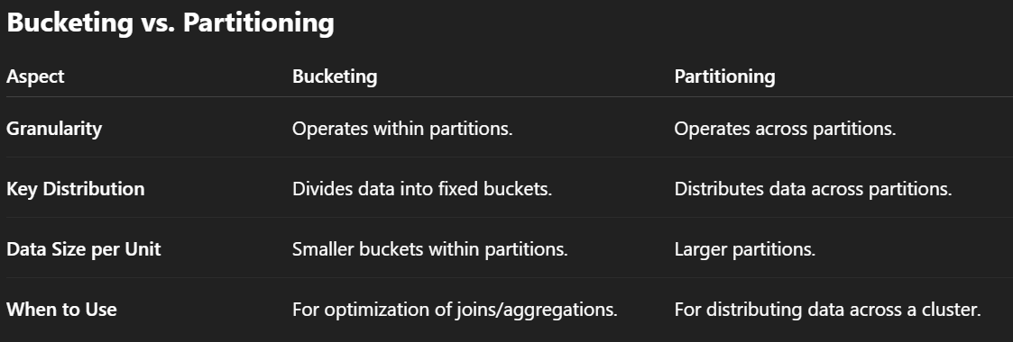

Slide 20
Spark Memory Management
Spark is a distributed data processing framework.
Executors handle task execution and memory management.
Key Components:
Task Execution
Storage of cached data and broadcast variables
Internal Spark processes
Evolution of Spark Memory Management
Pre-1.6: Managed by StaticMemoryManager.
Post-1.6: Managed by UnifiedMemoryManager.
Benefits of UnifiedMemoryManager:
Dynamic memory sharing between execution and storage.
Improved resource utilization.

Slide 21
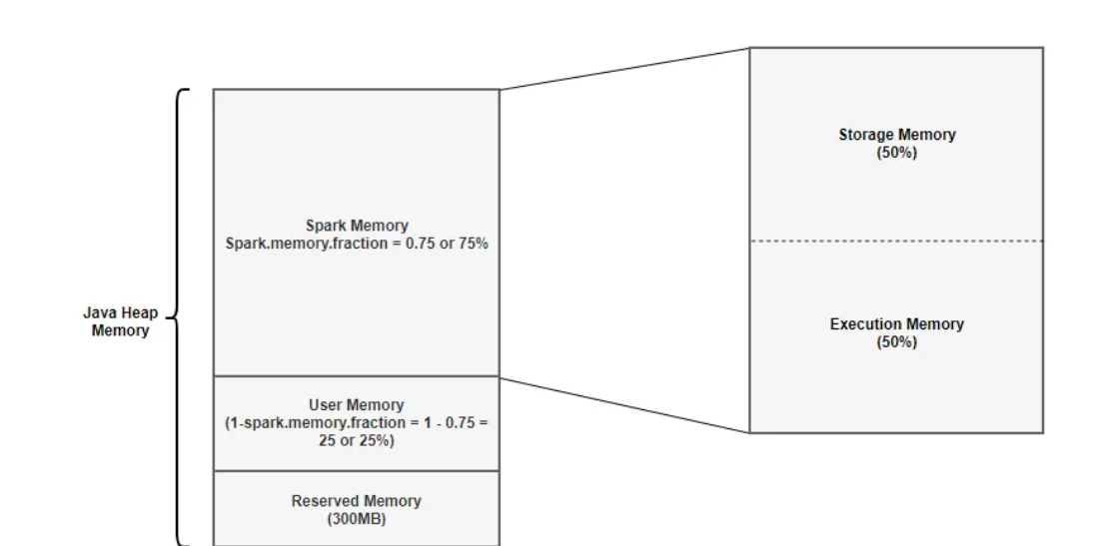
Excecutor Memory Breakdown
spark.memory.fraction (default: 0.75)
spark.memory.storageFraction (default: 0.5)
Memory Segments:
Reserved Memory
User Memory
Spark Memory (Execution & Storage)

Slide 22
Reserved Memory
Purpose: Used by Spark for internal operations.
Size: Fixed at 300MB.
Key Notes:
Not configurable unless Spark is recompiled.
User Memory
Purpose: Holds user-defined data structures and UDFs.
Formula:
User Memory=(Java Heap−Reserved Memory)×(1.0−spark.memory.fraction)
Example for 4GB Executor Memory:
User Memory=(4096−300)×(1.0−0.75)=949 MB

Slide 23
Spark Memory
Purpose: Managed by Spark for intermediate computations and cached datasets.
Formula:
Spark Memory=(Java Heap−Reserved Memory)×spark.memory.fraction
Example for 4GB Executor Memory:
Spark Memory=(4096−300)×0.75=2847 M
Spark Memory Segments
Execution Memory:
For intermediate data during tasks (e.g., hash tables, shuffle buffers).
Spill to disk when memory is insufficient.
Storage Memory:
For caching datasets and storing broadcast variables.
Evicts data using LRU policy.

Slide 24
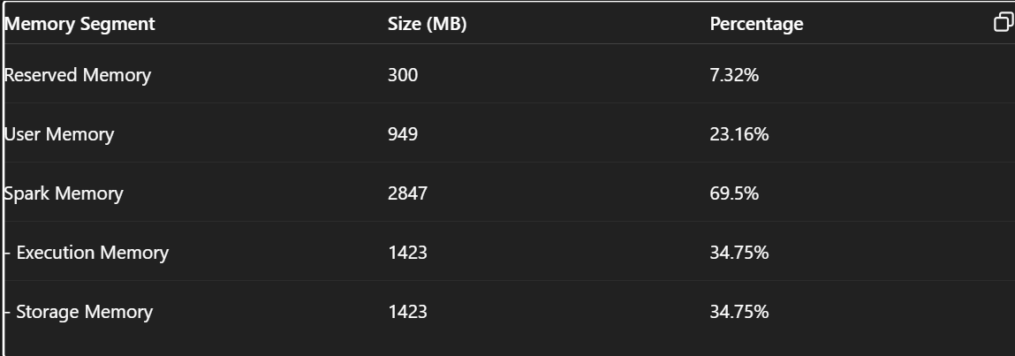
Dynamic memory Sharing
UnifiedMemoryManager allows:
Storage borrowing memory from Execution.
Execution borrowing memory from Storage.
Rules:
Execution memory cannot be evicted by Storage.
Storage memory can be evicted by Execution.

